Slide 1
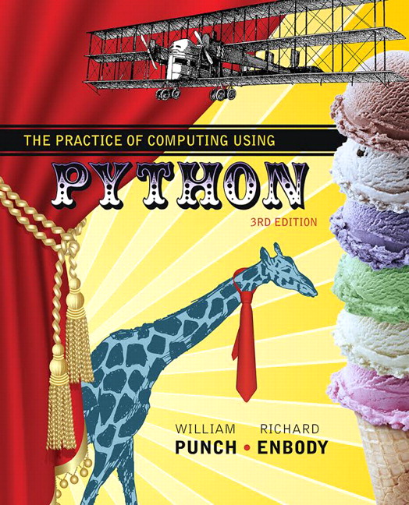
The Practice of Computing Using Python
Third Edition
Chapter 15
Recursion: Another Control Mechanism
Copyright © 2017, 2013, 2011 Pearson Education, Inc. All Rights Reserved
Notes:
If this PowerPoint presentation contains mathematical equations, you may need to check that your computer has the following installed:
1) MathType Plugin
2) Math Player (free versions available)
3) NVDA Reader (free versions available)

Slide 2
A Function that Calls itself
The very basic meaning of a recursive function is a function that calls itself
Leads to some funny definitions:
Def: recursion. see recursion
However, when you first see it, it looks odd.
Look at the recursive function that calculates factorial (code listing 16-2)

Slide 3
It Doesn’t Do Anything!
This is a common complaint when one first sees a recursive function. What exactly is it doing? It doesn’t seem to do anything!
Our goal is to understand what it means to write a recursive function from a programmers and computers view.

Slide 4
Defining a recursive function

Slide 5
1) Divide And Conquer
Recursion is a natural outcome of a divide and conquer approach to problem solving
A recursive function defines how to break a problem down (divide) and how to reassemble (conquer) the sub-solutions into an overall solution

Slide 6
2) Base Case
recursion is a process not unlike loop iteration.
You must define how long (how many iterations) recursion will proceed through until it stops
The base case defines this limit
Without the base case, recursion will continue infinitely (just like an infinite loop)

Slide 7
Simple Example
Lao-Tzu: “A journey of 1000 miles begins with a single step”
def journey (steps):
the first step is easy (base case)
the n^{th} step is easy having complete the previous n-1 steps (divide and conquer)

Slide 8
Code Listing 15-1

Slide 9
Factorial
You remember factorial?
factorial(4) = 4! = 4 * 3 * 2 * 1
The result of the last step, multiply by 1, is defined based on all the previous results that have been calculated

Slide 10
Code Listing 15-2

Slide 11
Trace the calls
start first function invocation
start second function invocation
start third function invocation
fourth invocation, base case
third invocation finishes
second invocation finishes
first invocation finishes

Slide 12
Another: Fibonacci
Depends on the Fibonacci results for the two previous values in the sequence
The base values are Fibo(0) == 1 and Fibo(1) == 1

Slide 13
Code Listing 15-3

Slide 14
Trace

Slide 15
Reverse string
We know Python has a very simple way to reverse a string, but let’s see if we can write a recursive function that reverses a string without using slicing.

Slide 16
Code Listing 15-4 Template for reversal

Slide 17
Base Case
What string do we know how to trivially reverse?
Yes, a string with one character, when reversed, gives back exactly the same string
We use this as our base case

Slide 18
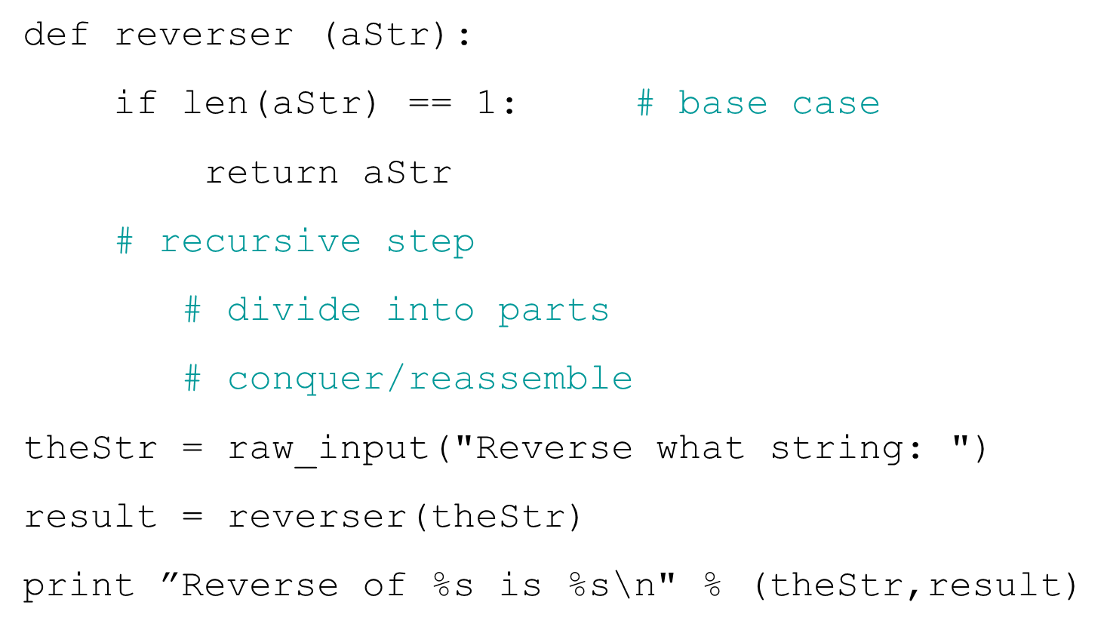
Code Listing 15-5

Slide 19
Recursive Step
We must base the recursive step on what came before, plus the extra step we are presently in.
Thus the reverse of a string is the reverse of all but the first character of the string, which is placed at the end. We assume the rev function will reverse the rest

Slide 20
Code Listing 15-6 (1 of 2)

Slide 21
Code Listing 15-6 (2 of 2)

Slide 22
How does Python keep track?

Slide 23
The Stack
A Stack is a data structure, like a List or a Dictionary, but with a few different characteristics
A Stack is a sequence
A stack only allows access to one end of its data, the top of the stack

Slide 24
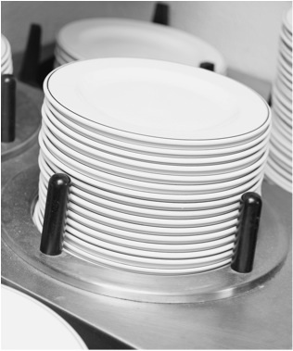
Figure 15.1

Slide 25
Operations
pop : remove top of stack. Stack is one element smaller
push(val): add val to the stack. Val is now the top. Stack is one element larger
top : Reveals the top of the stack. No modification to stack

Slide 26
Figure 15.2 The operation of a Stack Data Structure

Slide 27
Stack of Function Calls
Python maintains a stack of function calls.
If a function calls another function recursively, the new function is pushed onto the calling stack and the previous function waits
The top is always the active function
When a pop occurs, the function below becomes active

Slide 28
Code Listing 15-7 (1 of 2)

Slide 29
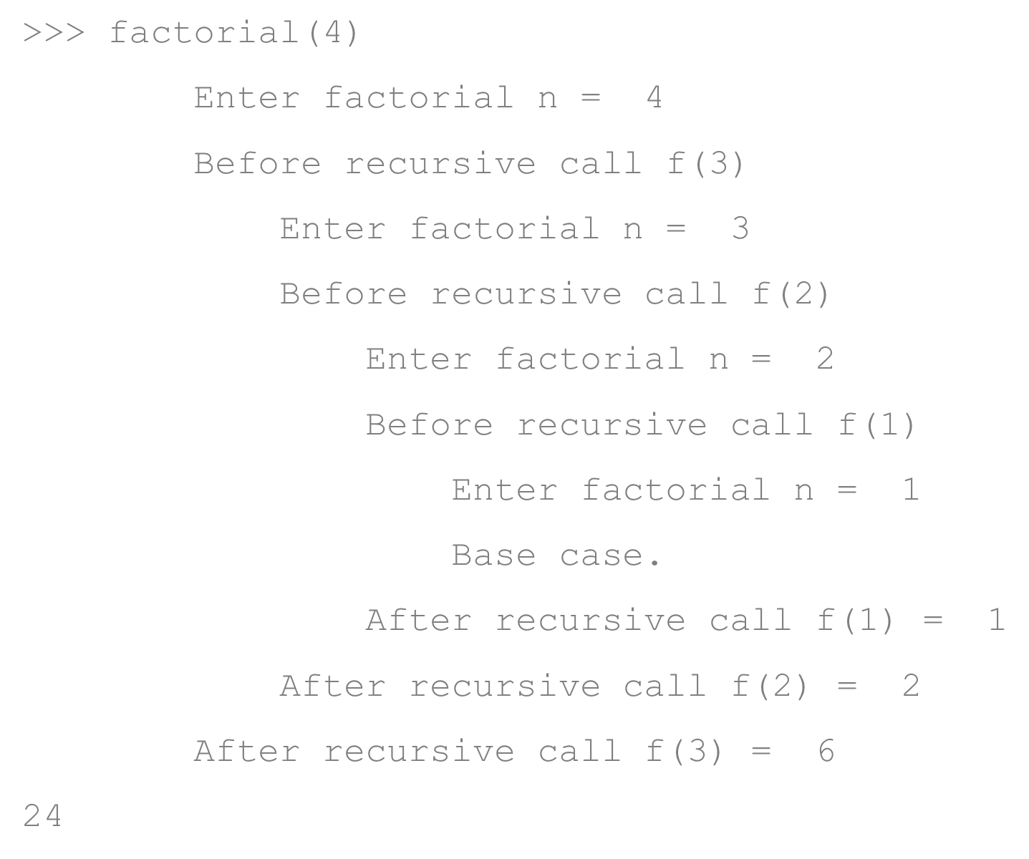
Code Listing 15-7 (2 of 2)

Slide 30
Figure 15.3 Call stack for factorial(4)
Note the question marks.

Slide 31
A Better Fibonacci
The recursive function that we have written previously is very wasteful
It calls the function with the same argument many times, never "remembering" the previous result.

Slide 32
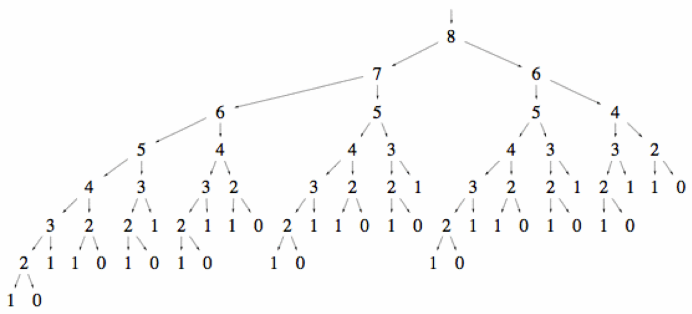
Figure 15.4 The Simple Fibonacci Code Recalculates the Same Value

Slide 33
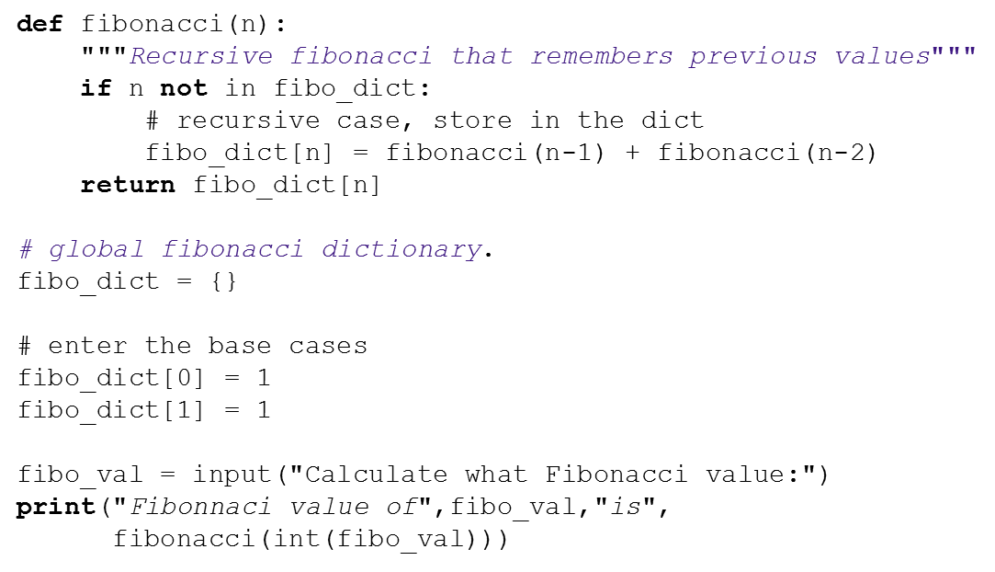
Code Listin 15.8 Fibonacci with memory

Slide 34
Recursive Figures

Slide 35
Fractal Objects
You can use recursion to draw many real world figures
Fractals are a class of drawing that has a couple of interesting properties:
upon magnification, the “shape” of the figure remains the same
the resulting figure has a floating point dimensionality value (2.35 D for example)

Slide 36
Algorithm to Draw a Tree
Draw an edge
turn left
draw edge and left branch # recurse
turn right
draw edge and right branch #recurse
turn left
backup

Slide 37
Code Listing 15-9

Slide 38
Couple things
note that length is reduced as we recurse down (making for shorter branches)
the numbers on the right of the following picture show the order in which the branches are drawn

Slide 39
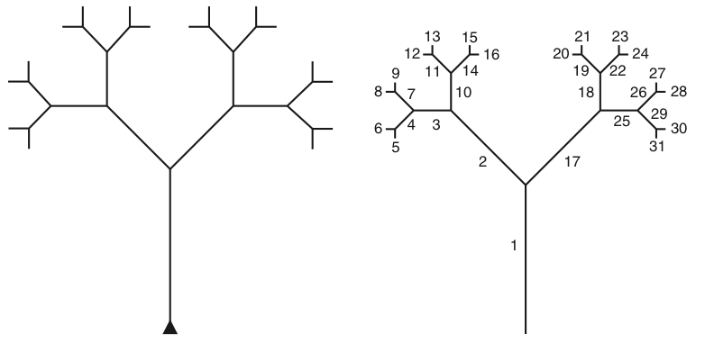
Figure 15.5 Recursive Tree
(a) Python-drawn (left); (b) order-of-drawing on right.

Slide 40
Sierpinski Triangles
Little simpler than the tree:
draw edge
recurse
backward
turn 120 degrees

Slide 41
Code Listing 15.10 Sierpinski Triangles

Slide 42
Figure 15.6 Sierpinski Triangle

Slide 43
Some Recusive details
Recursive functions are easy to write and lend themselves to divide and conquer
They can be slow (all the pushing and popping on the stack)
Can be converted from recursive to iterative but that can be hard depending on the problem.

Slide 44
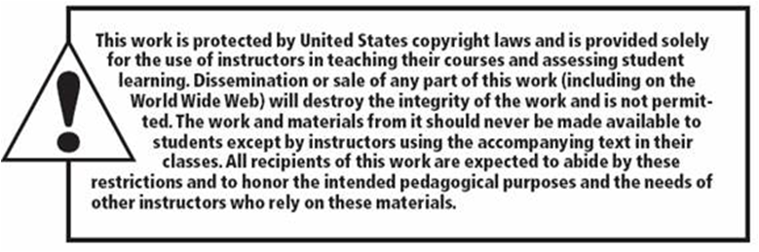
Copyright

